Slide 1


Development of a wearable FET-based sensor for detecting creatinine in sweat samples
AY 2021-2025
GITAM UNIVERSITY
Major Project
Project ID: V3
A University should be a place of light, of liberty, and of learning.
Department of Electrical Electronics and Communication Engineering
Project Team:
SanaSayeeda
S Aparna
B Manjulatha
Project Mentor:
Dr. Lignesh BD
www.gitamedu.com

Slide 2


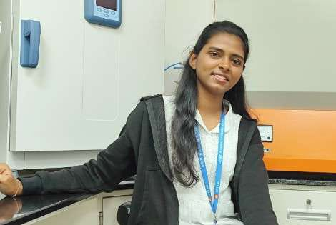
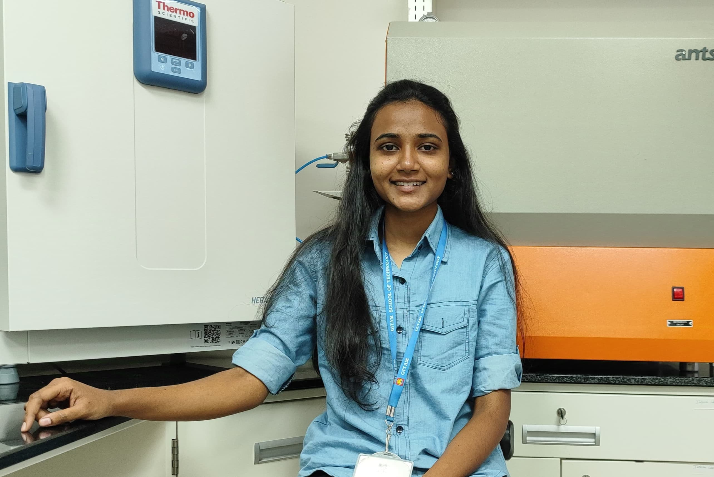
Project Group – Details
Photo
Track
Roll No
Name
Photo
EECE AI/ML
BU21EECE0100268
SANA SAYYEDA
Photo
EECE AI/ML
BU21EECE0100324
S APARNA
Photo
EECE AI/ML
BU21EECE0100211
B MANJULATHA

Slide 3

Objective and Goals
Objective
To design and develop a wearable FET-based sensor for the sensitive and selective detection of creatinine in sweat.
To enable non-invasive, continuous monitoring of kidney function for early diagnosis and management of renal health.
Expected Outcomes
Synthesis of nano materials
Development of Wearable patch
Analyse of concentration of particular substance
Smartphone Integration

Slide 4
Project Plan
Resources :
Mxene
Analytical balance
Tubular furnace
Nitrogen gas
Sweat samples

Slide 5
Literature Survey
Key Publications
https://jnanobiotechnology.biomedcentral.com/articles/10.1186/s12951-023-02153-1
https://www.mdpi.com/2227-9040/11/9/470
https://www.ncbi.nlm.nih.gov/pmc/articles/PMC10629051/
Key Resources – Whitepaper| Application Notes | Datasheet| Others papers
White papers :
Overview of Wearable Sensors: Whitepapers from industry leaders or academic institutions that provide a broad view of wearable sensor technology, its current state, and future trends.
Biosensing with FETs: Detailed whitepapers explaining the mechanisms of FET-based biosensors, including surface chemistry, sensor response, and noise reduction techniques.
Application Notes :
Device Calibration and Testing: Technical notes on how to calibrate FET-based sensors for accurate biomarker detection in sweat, including protocols for sensor testing and data validation.
Integration with Wearable Electronics: Application notes discussing the integration of FET sensors into wearable devices, covering aspects such as power management, signal processing, and data transmission.
Biocompatibility and Wearability: Guidelines on ensuring that the wearable sensor is biocompatible and comfortable for long-term use on the skin.

Slide 6
Analysis - SWOT
Strengths
Weaknesses
W1. Power consumption
W2. Interface from other sweat components
W3. Durability and stability
W4. Sweat collection challenges
S1. Non-invasive Monitoring
S2. Continuous monitoring
S3. Potential for integration
Threats
Opportunities
T1. Durability
T2. False positive False negative
T3. Non-responsive device
T4. Short circuits or water-based interactions will effect sensitivity
O1. Partnership and collaboration
O2. Rising prevalence of chronic kidney disease (CKD)
O3. Advancements in flexible electonics

Slide 7
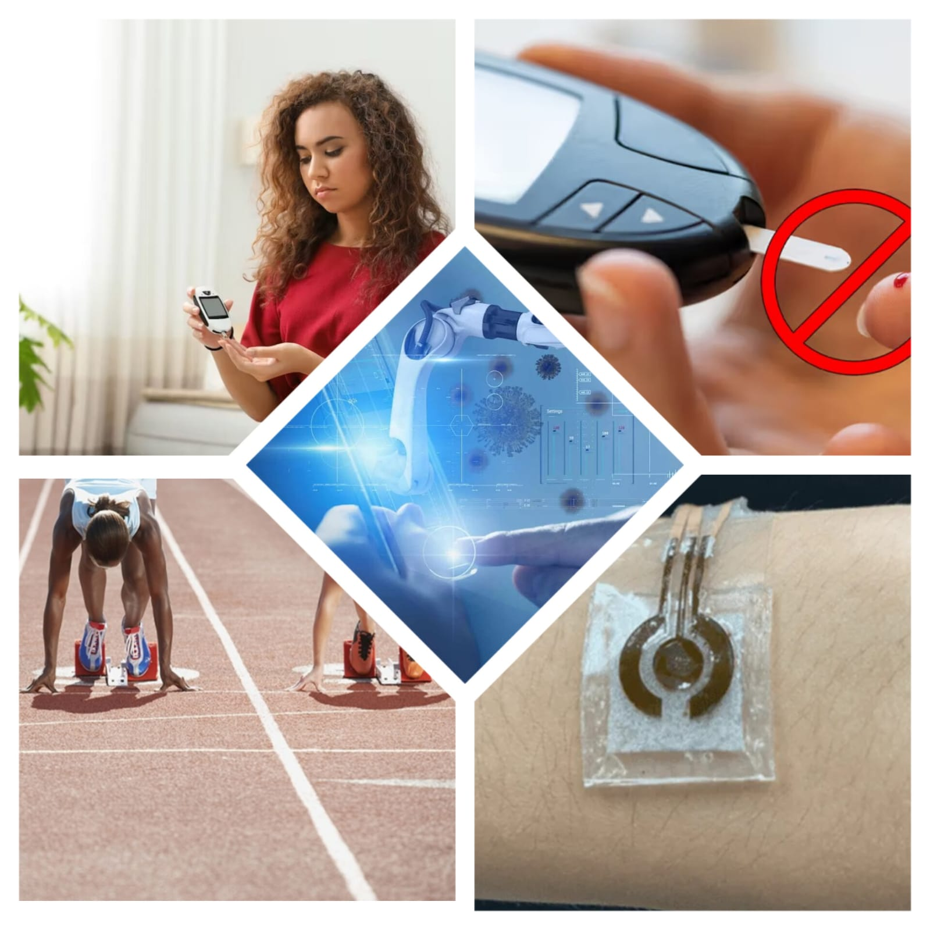
Analysis – 4W1H
Why: Develop a non invasive biosensor for creatinine sensing in sweat
What: Fabricating a Wearable Biosensor for detecting creatinine
Where: point of care diagnosis
When: Early stages of Chronic Kidney Disease (CKD)
How: MXene based FET (Field Effect Transistor)
Refined Objective: To develop a point of care diagnostic platform aimed for early diagnosis of CKD

Slide 8
Architecture/Flow chart
Synthesis of MXene Nanomaterials
Fabrication of FET
Sensitivity and Stability Analysis
Wearability Analysis
Bluetooth enabled Smartphone Integration
Repeatability Analysis
Product Demo

Slide 9
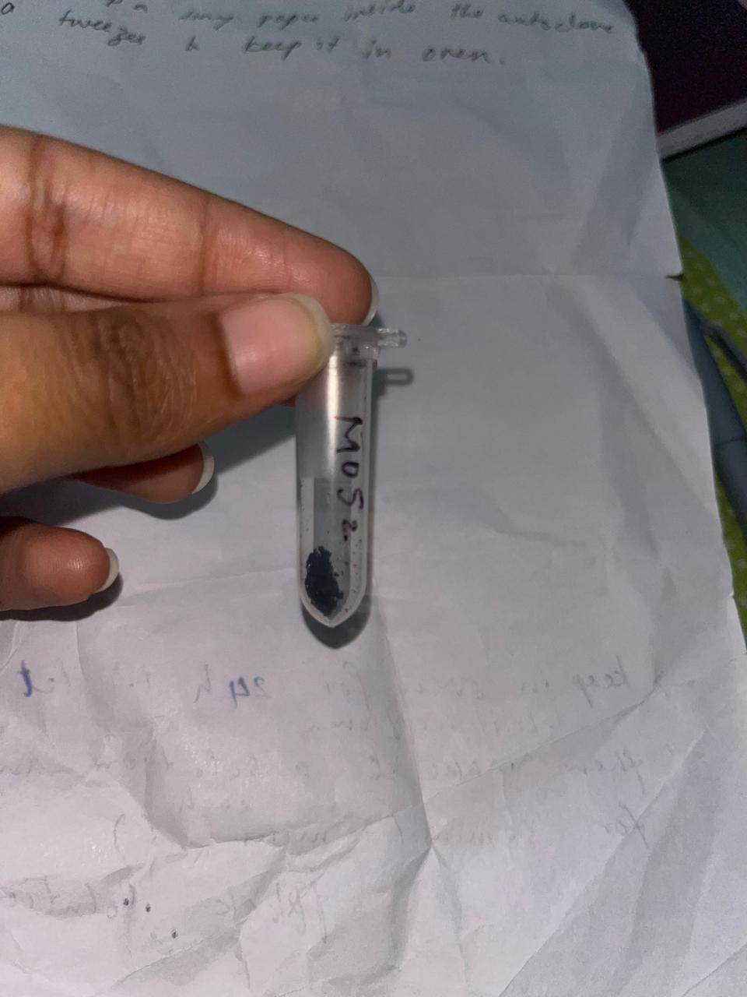
Implementation and Results – Iteration 1
Iteration 1 : Results
Fabrication of MoS2 on Paper:
Few Salts in a calculated
amount is taken and mixed
in distilled water.
With a piece of paper in
the solution, keep it in
autoclave for 12 hours.

Slide 10
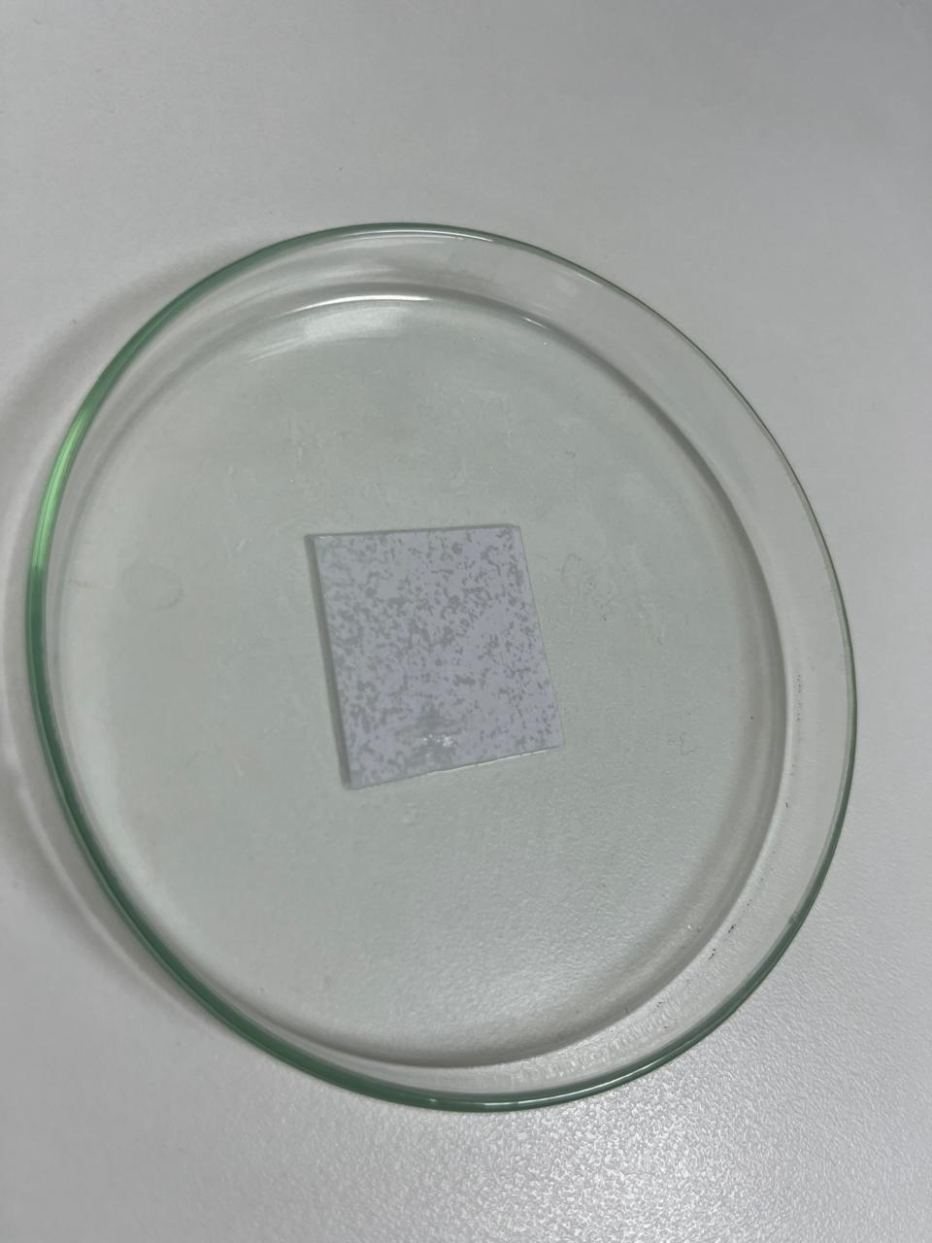
Implementation and Results – Iteration 2
Iteration : Results + Validation against the usecases and test cases

Slide 11
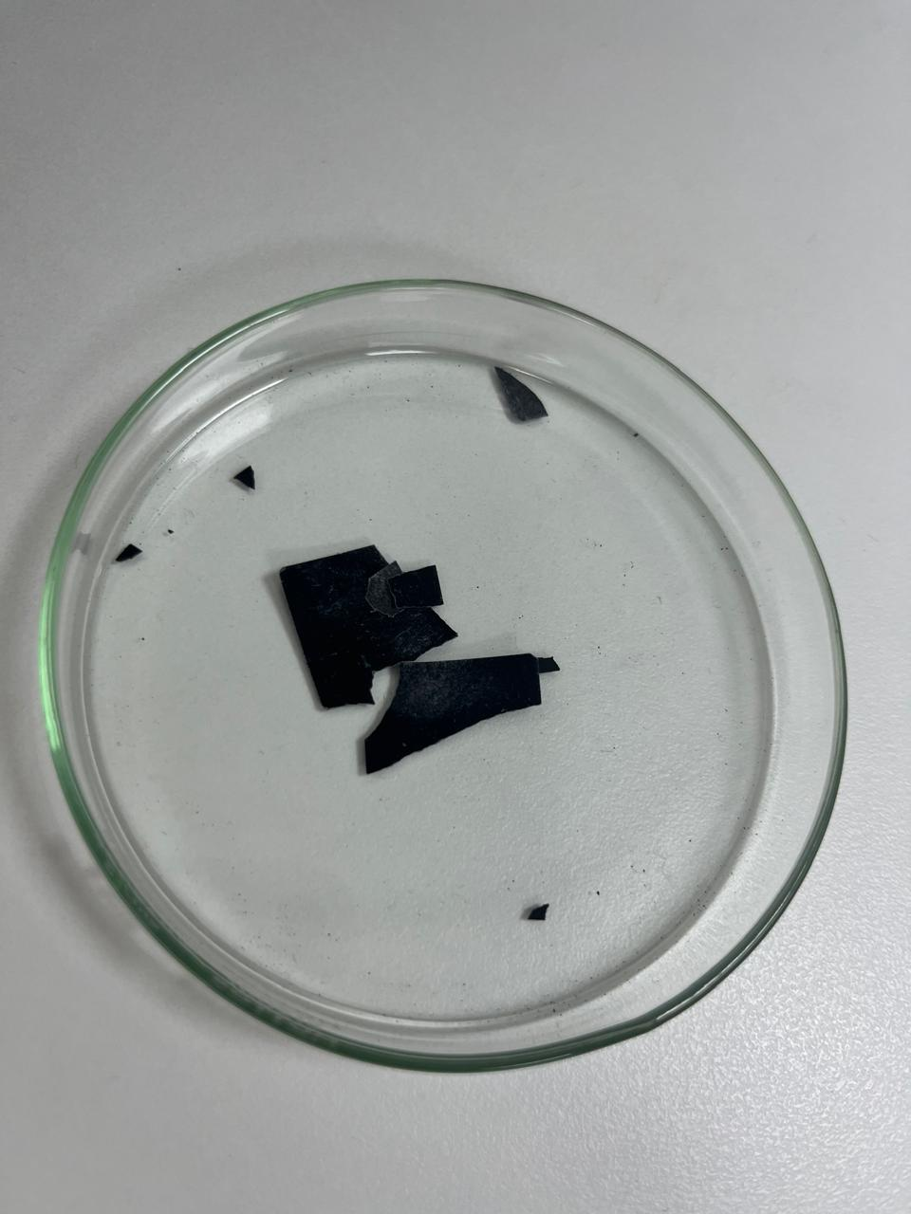
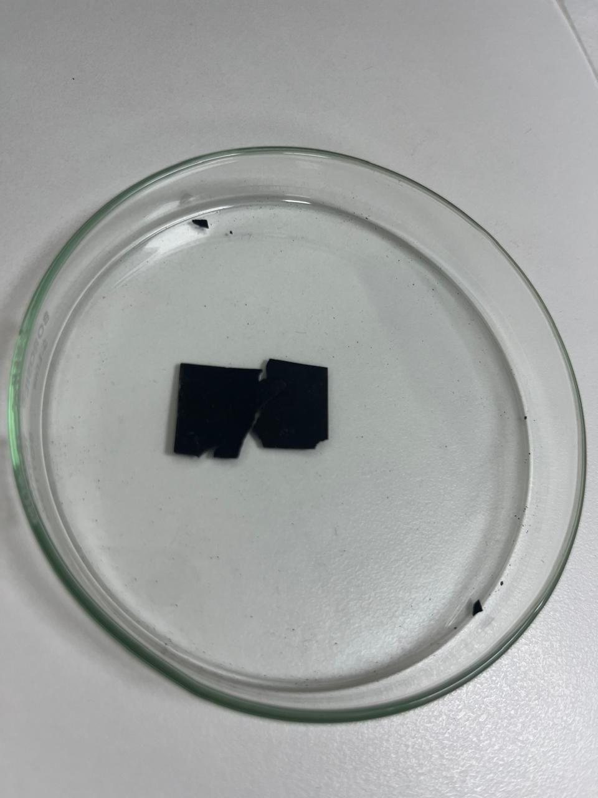
Implementation and Results – Iteration 3 (Optional)
Iteration : Results + Validation against the usecases and test cases

Slide 12
Contribution
Team Progress and Movement
Team collaboration on literature survey, design, and initial testing.
Joint efforts in synthesis of MXene and fabrication of FET-based sensor.
Individual Contribution
Key contributions: Sana Sayeeda
Led the synthesis of MXene nanomaterials.
Contributed to sensor fabrication and wearability analysis.
Assisted in conducting the SWOT analysis for the project.
Key contributions: S Aparna
Involved in sensitivity and stability testing of the sensor.
Led efforts on data collection and analysis for repeatability and performance consistency.
Key contributions: B Manjulatha
Contributed to the literature review and resource gathering.
Involved in product design and creating the flowchart/architecture for the project.

Slide 13
Conclusion & Future Work
Summary and Conclusion
The synthesis of MXene and the fabrication of MoS2-based FET has been successfully initiated, with promising preliminary results.
The project demonstrates the potential for a non-invasive, wearable sensor that can monitor creatinine levels in sweat, offering a new method for early diagnosis of CKD.
In conclusion, We have processed MoS2 ink comprising of MoS2 nanoparticles.
We have also grown MoS2 film on paper which made the paper brittle in nature.
Future Work
Further testing of MoS2 in sensor design.
designing a circuit on the MoS2 paper to be used as FET
Once fully developed, the sensor will allow for continuous monitoring and could be integrated with smartphone apps for real-time data transmission.
Future work will focus on improving sensor stability, sensitivity testing, and Bluetooth integration for seamless use in healthcare settings.

Slide 14

THANK YOU

